Slide 1
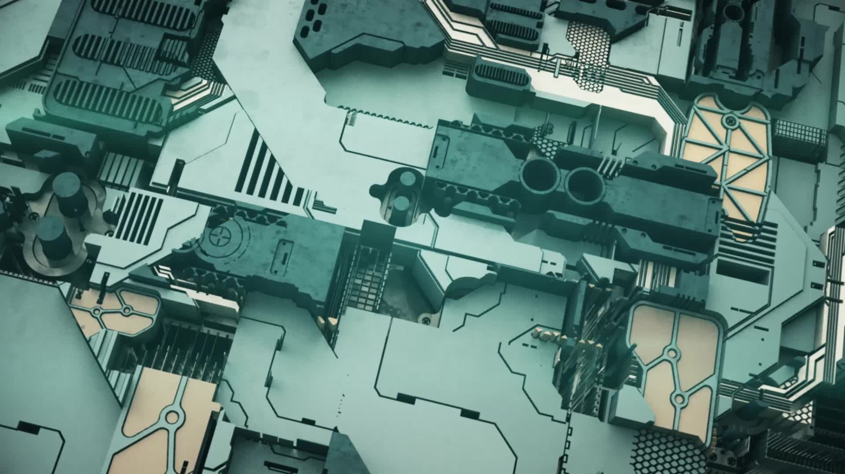
Computer Equipment

Slide 2


Type
PC
Mac
Mini Computer (Raspberry Pi)
Thin Client

Slide 3
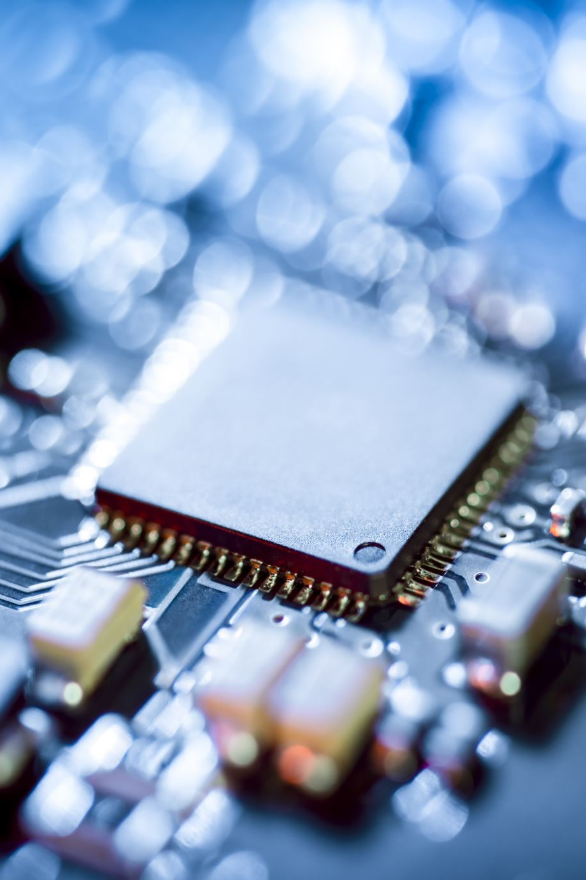
Computer Components
Tower/Laptop
Motherboard
Storage
Ram
CPU
Power Supply
Operating System
Video Card
Monitor
Input/Output

Slide 4
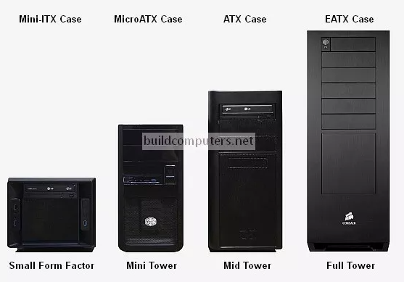
Tower
Holds the computer components
Comes in many shapes and sizes

Slide 5
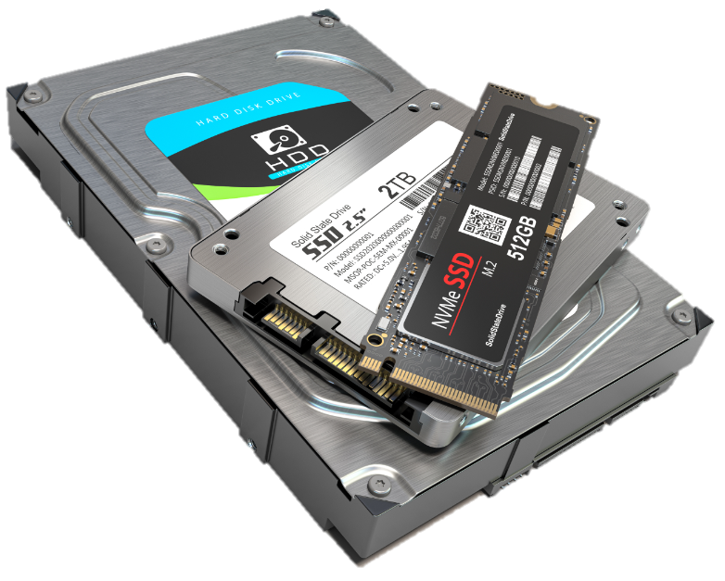
Storage
Types of Storage
Spinning Disk
SSD
Hybrid
M2

Slide 6
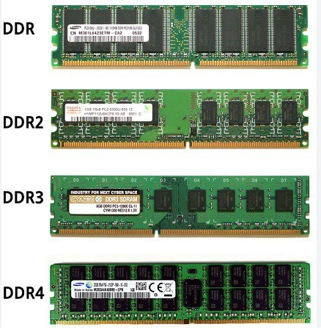
Ram
Data Storage for CPU
Caches Frequently Accessed Data
Increases System Performance

Slide 7
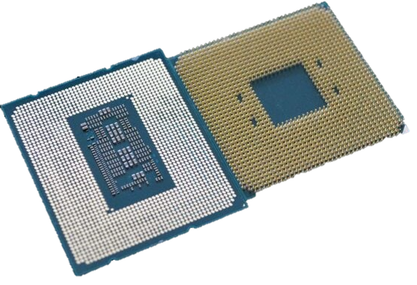
CPU
The Brains Of The Computer
Data Processing
Fetch
Decode
Execute

Slide 8
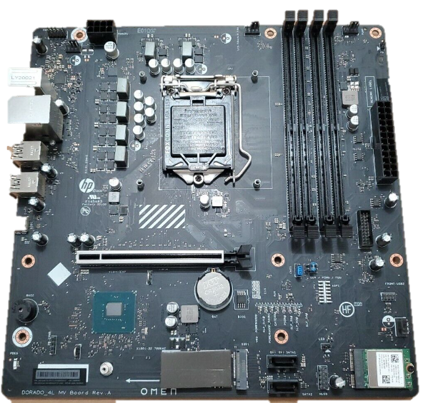
Motherboard
Component Integration
Power Distribution
Data Communication
Contains Bios and Firmware
Provides Expansion Slots
System Configuration and Management
Basic Input and Output

Slide 9
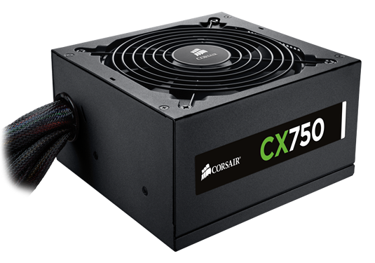
Power supply
Supplies Power For Computer
Converts AC to DC Power
Power Distribution to Components

Slide 10
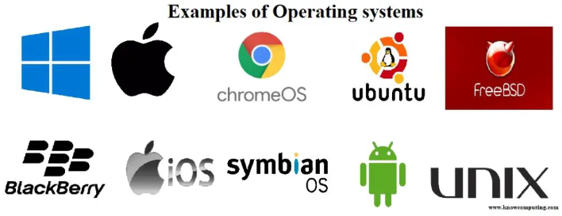
Operating System
User Interface
Memory Management
File System Management
Device Management
Many Different Types
Windows
MacOS
Linux

Slide 11
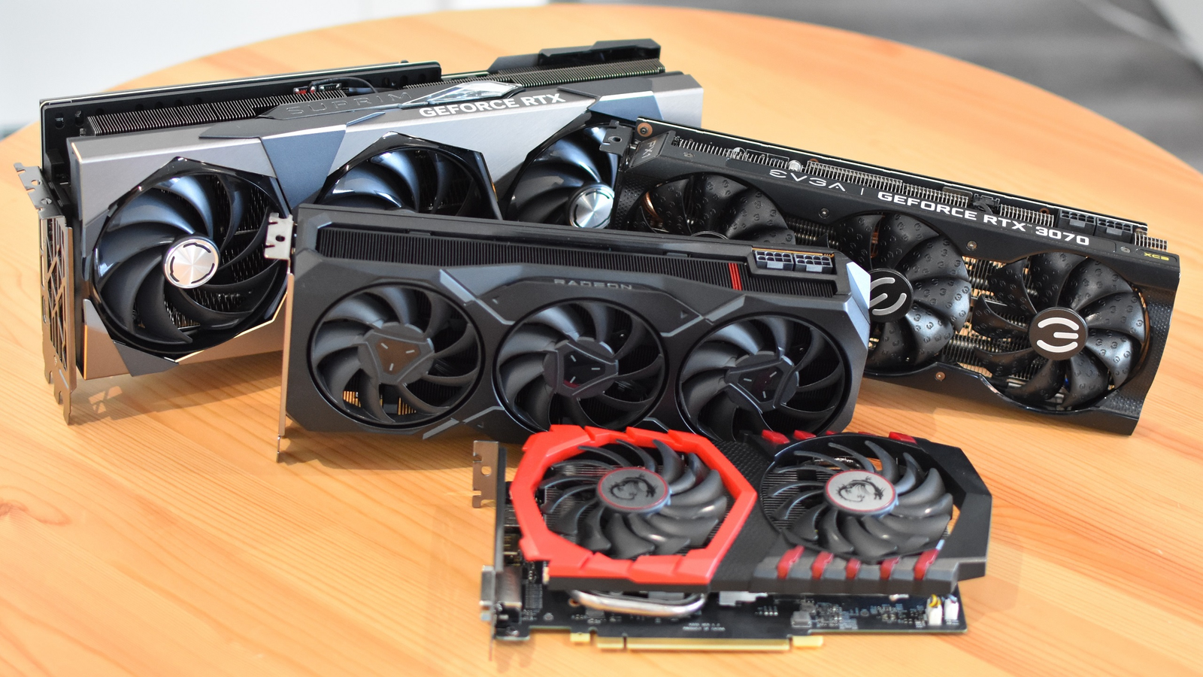
Video Card
Not Needed For Most Uses
Connects to Motherboard
Renders Complicated Graphics
Are Usually Quite Expensive

Slide 12
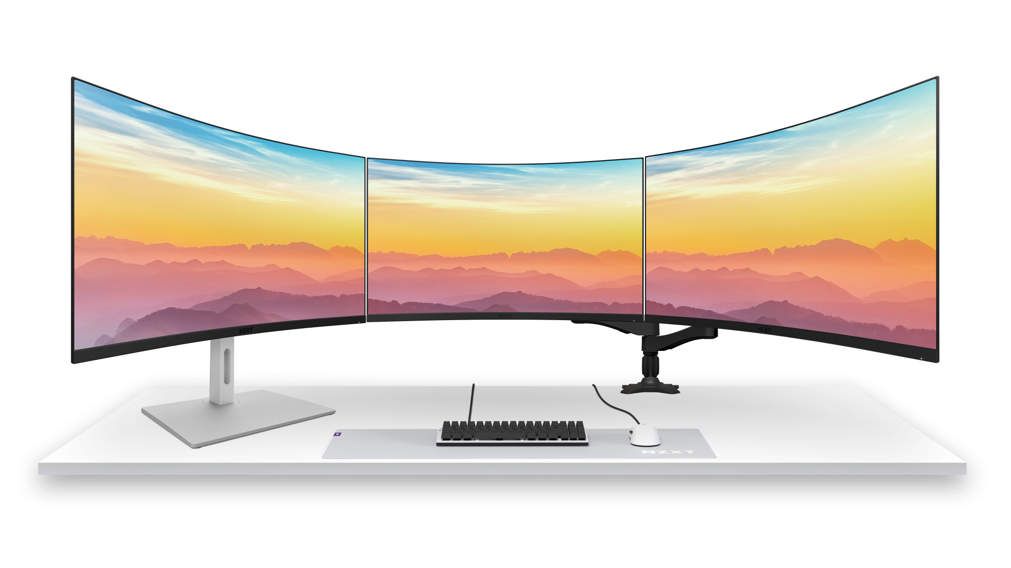
Monitor
Visual Output
User Interface

Slide 13
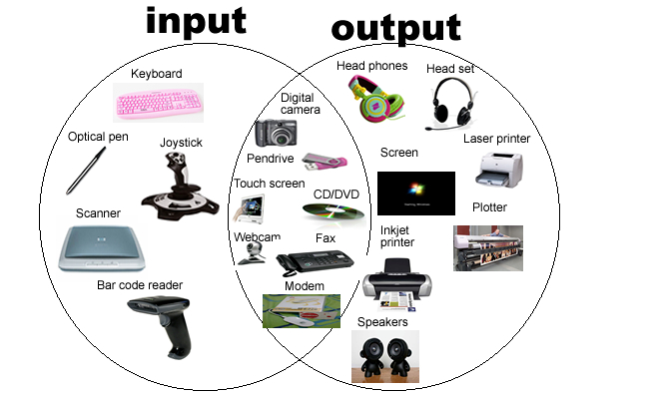
Input/Output
Keyboard/Mouse
Video Cables
VGA
Parallel
HDMI
Display
Power Cables
Audio Cables
Monitor
Printers/Scanners
Webcam

Slide 14
Helpful Websites
https://pcpartpicker.com/
https://www.tomshardware.com/
https://www.anandtech.com/
https://www.reddit.com/r/buildapc/
https://www.newegg.com/

